Slide 1
Energy efficiency and performance analysis verletlist vs clusterpair on Intel Sapphire Rapids
Ashwin Varkey
Matriculation number:23115420
MSc. Computational Engineering

Slide 2

Task
The task is to pick a CPU architecture (Intel Sapphire Rapids) and build and run MD-Bench analysis for solid copper test case.
One specific compiler
Different SIMD vector lengths
Single vs Double Precision Study
Full neighbor list vs Half neighbor list configuration
Compare Verletlist and Clusterpair

Slide 3
Compare Verletlist and Clusterpair
Benchmarks
Data Volume Analysis
Instruction Count Analysis
Performance Analysis
Scalability study
Energy Analysis (only for Verletlist)

Slide 4
Test system
Testcase description
Force field: lj
Unit cells (nx, ny, nz): 32, 32, 32
Domain box sizes (x=y=z): 5.374708e+01
Data layout: AoS
Floating-point precision:DP/SP
Lattice size: 1.679596e+00
Epsilon: 1.000000e+00
Sigma: 1.000000e+00
Temperature: 1.440000e+00
RHO: 8.442000e-01
Mass: 1.000000e+00
Number of timesteps: 200
Reneighbor every (timesteps): 20
Sort atoms: yes
Delta time (dt): 5.000000e-03
Cutoff radius: 2.500000e+00
Skin: 3.000000e-01
Half neighbor lists: 0 or 1 (for half)
Host/Clustername: saprap2
CPU name:Intel® Xeon® Platinum 8470 processor
CPU type: Intel Sapphire Rapids processor
Base Frequency: 2.00 GHz
Max Turbo Frequency: 3.80 GHz
Memory capacity: 503 GB
Number of cores per node: 52 cores
Interconnect:PCIe®
Threads per core: 2 (SMT active)
Compiler: intel/2023.2.1 (ICC)
LIKWID Tools:likwid/5.4.0
Slurm :slurm/23.02.7

Slide 5
Build software
Begin by editing config.mk, which contains various configurations that determine how the code will be compiled and optimized. For our case the conditions are:
TOOLCHAIN: ICC
ISA: x86
SIMD: : NONE, SSE, AVX, AVX512
OPT_SCHEME: Verlet List (VL) and Cluster Pair (CP)
ENABLE_LIKWID: True
ENABLE_OPENMP: True
DATA_TYPE: SP and DP
DATA_LAYOUT: AOS
SORT_ATOMS: True
ONE_ATOM_TYPE: False
ENABLE_OMP_SIMD: True
COMPUTE_STATS: True
Allocating node on testcluster
salloc -t 03:00:00 --exclusive -w saprap2 -c 64 -p work -C hwperf
Running application
likwid-perfctr -C 0 -g FLOPS_DP -m ./MDBench-VL-ICC-X86-AVX512-DP

Slide 6
Single Core

Slide 7
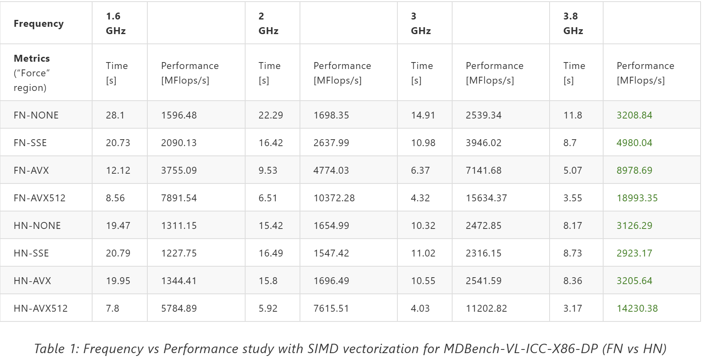
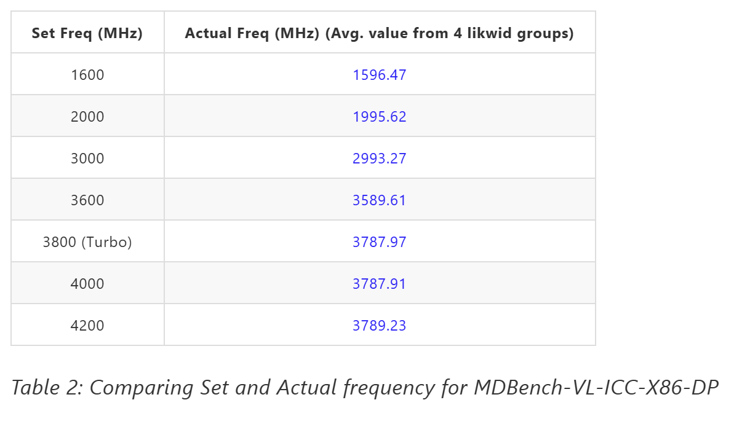
Frequency Study
srun --cpu-freq=<freq in KHz>-< freq in KHz >:performance likwid-perfctr -C 0 –g FLOPS_DP -m
./MDBench-VL-ICC-X86-DP
Turbo mode is capped at 3800 MHz, even with settings above this limit (e.g., 4000 MHz, 4200 MHz).
Higher CPU frequency improves performance by executing more instructions per second.
Turbo mode temporarily increases frequency within thermal and power constraints.

Slide 8
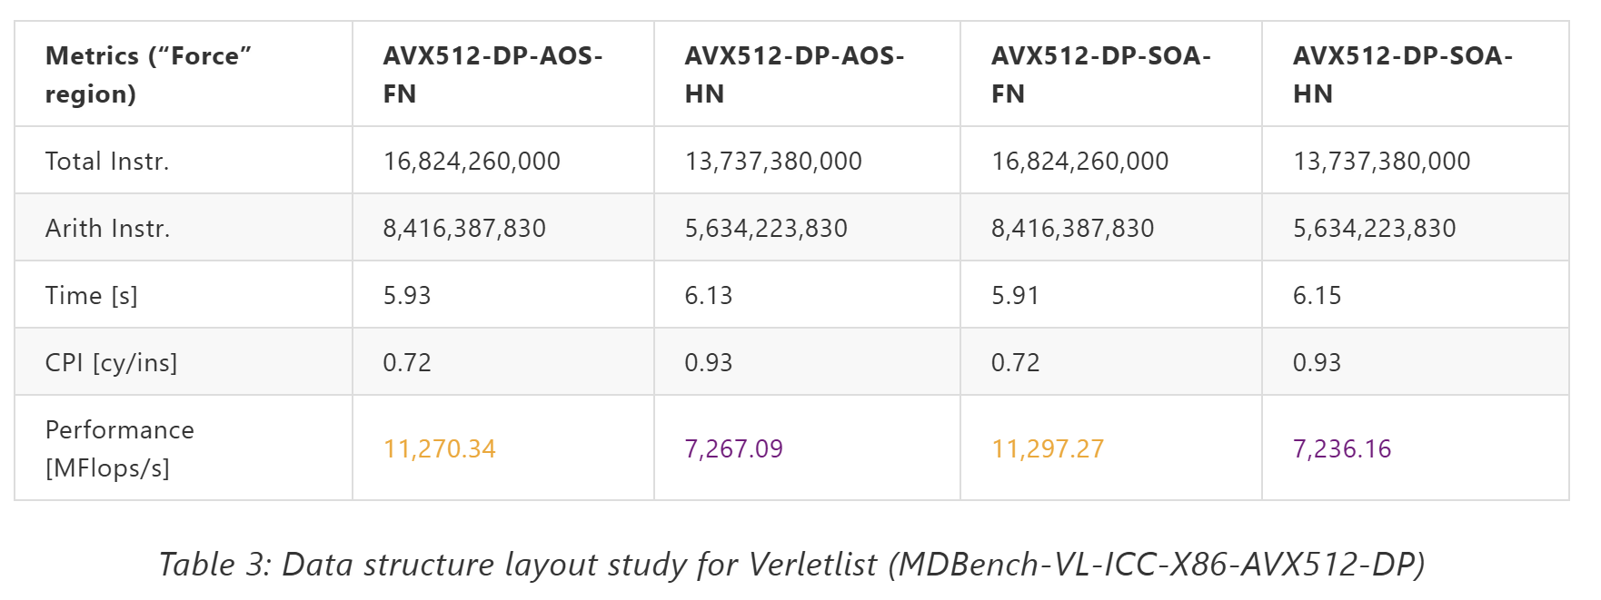
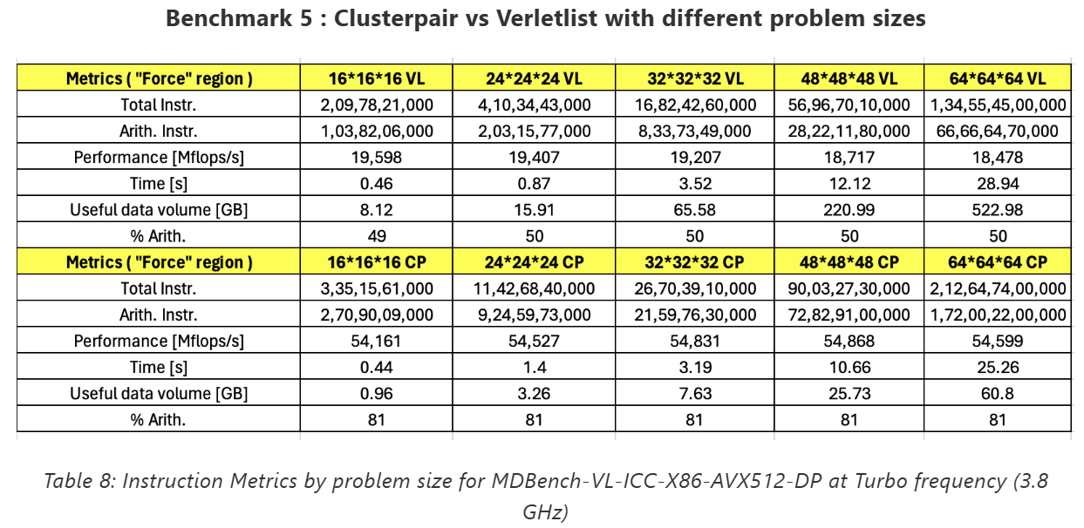
Benchmarks
1 ) The benchmark comparing Array-of-Structures (AoS) and Structure-of-Arrays (SoA) in Verletlist reveals no significant performance differences for the different SIMD testcases.
2) Sorting doesn't affect performance with almost similar values in Verletlist and Clusterpair
Sort FN HN w/o Sort FN HN
3) As the problem size increases, the total number of instructions grows significantly.
For the same problem size, Clusterpair (CP) consistently executes more arith. instructions than Verletlist (VL).
CP is more optimized for computational efficiency, with 81% of its instructions being arithmetic, while Verletlist is limited by non-computational operations.

Slide 9
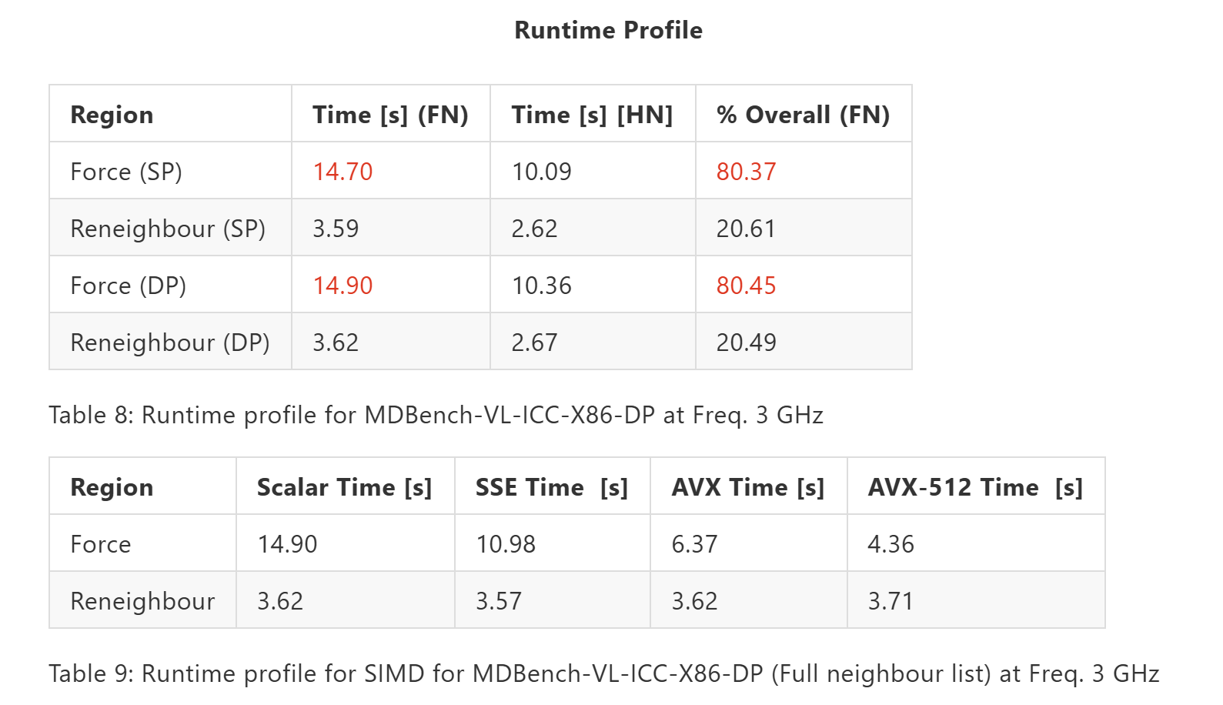
Runtime Profile-Verletlist
srun --cpu-freq=3000000-3000000:performance likwid-perfctr -C 0 FLOPS_DP -m ./MDBench-VL-ICC-X86-DP
Force region bottleneck: accounts for approximately 81-83% of runtime in both single (SP) and double precision (DP)
Runtime decreases with increasing SIMD width in force region and the reneighboring region shows no improvement
Half neighbor (HN) strategy advantage: scalar case improvement by reducing neighbor list update costs at each timestep

Slide 10
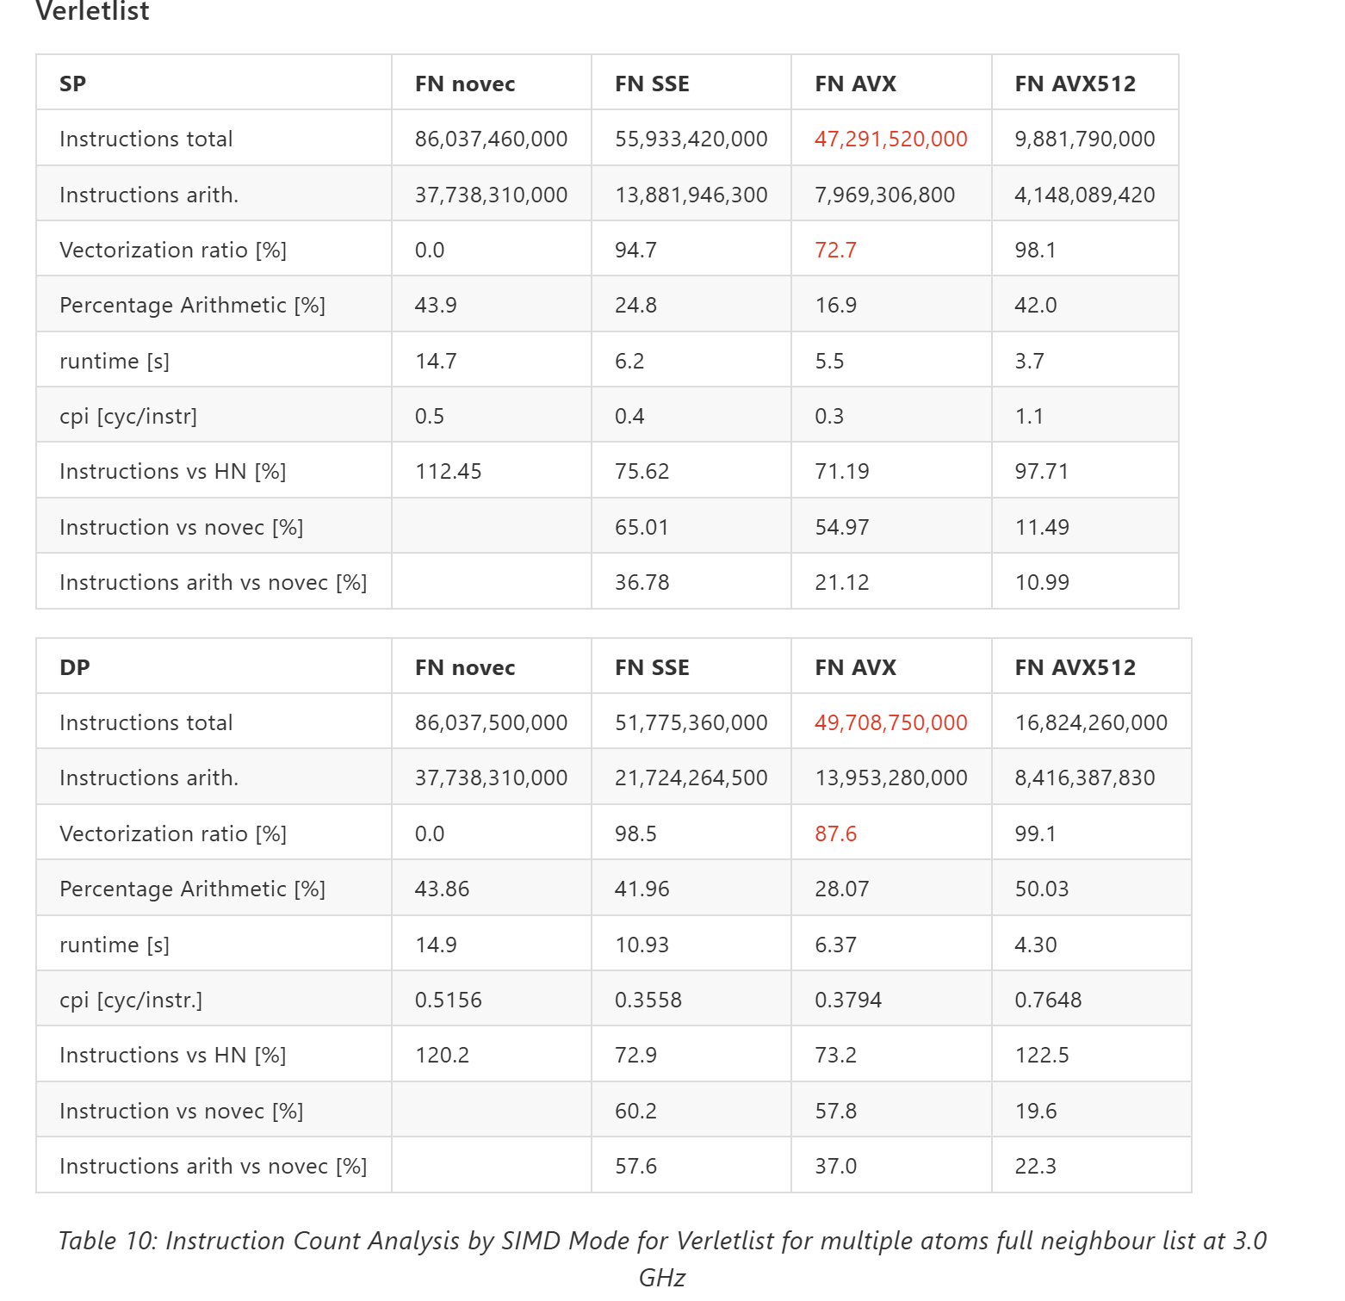
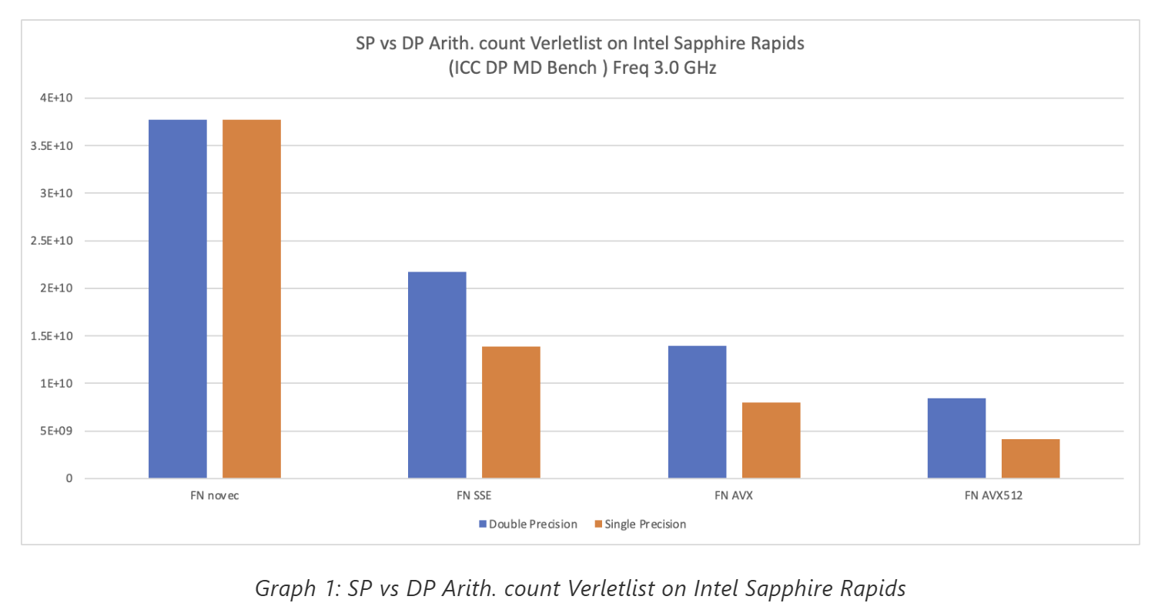
Instruction count analysis
Total Instruction counts (both arith. and total.) and runtime tends to go down with increasing SIMD vectorization length
AVX512 most efficient vectorization and low instruction counts (total and arith.) and a high vectorization ratio of 99.1% in double precision.
DP to SP shows a slight improvement in runtime with a 1.5-2x reduction in arithmetic counts as expected
srun --cpu-freq=3000000-3000000:performance likwid-perfctr -C 0 FLOPS_DP -m ./MDBench-VL-ICC-X86-AVX512-DP

Slide 11
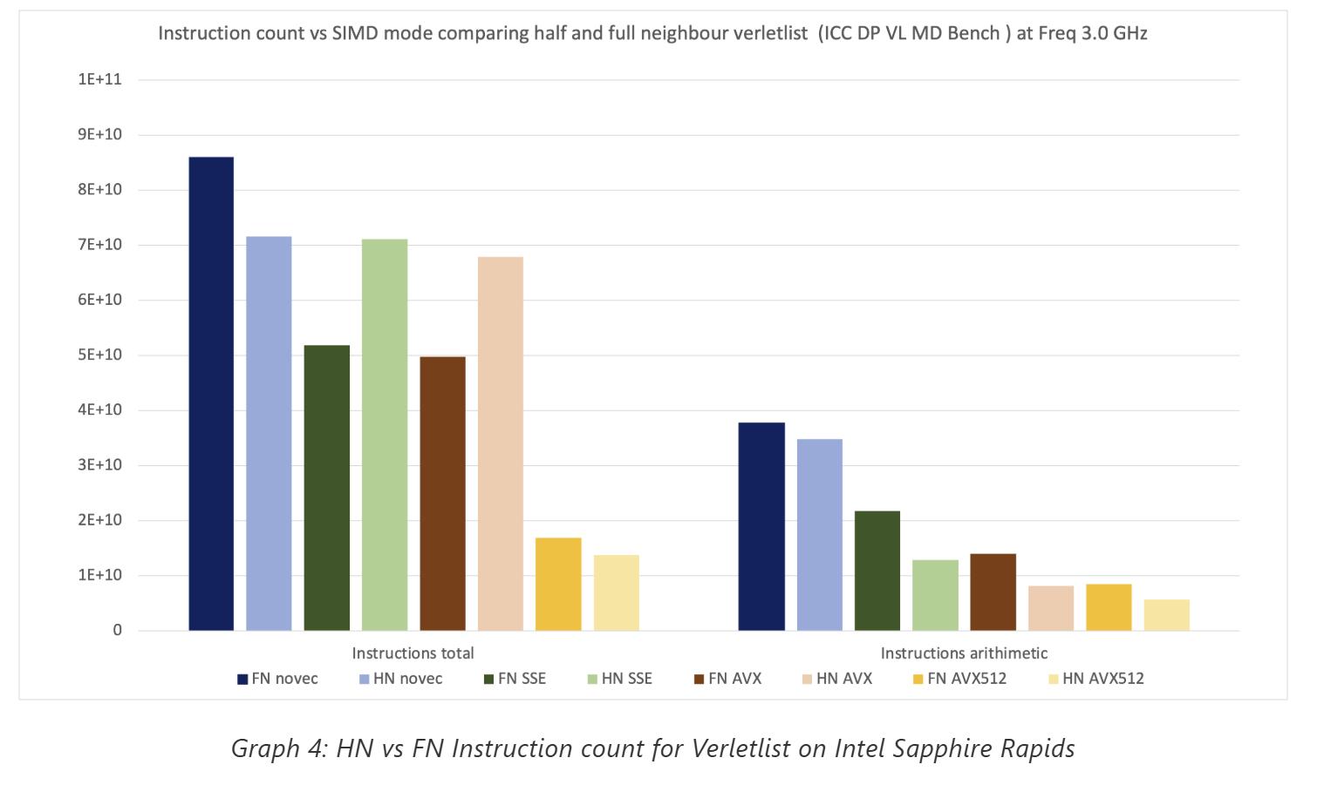
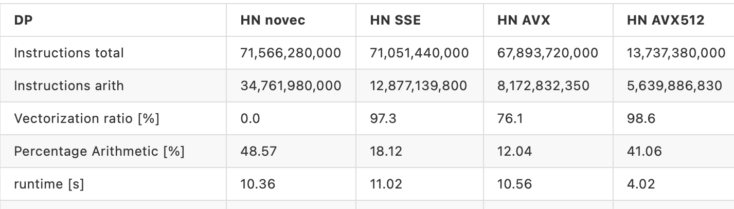
SIMD mode
Neighbour list
Arithmetic instructions decrease by the SIMD factor, but total instructions remain unchanged, indicating SIMD overhead with AVX registers.
AVX2 and AVX512 support vectorizing like the gather instructions.
AVX2 is not working in ISR
AVX and its predecessors require separate load instructions, increasing instruction count and complicating vectorization, often causing arithmetic operations to fall back to SSE.
Half-Neighbor show limited performance gains across SIMD variants resulting in lower vectorization ratios and no runtime improvement.
Full neighbor list has better alignment with SIMD register width reduces overhead and improves performance.

Slide 12
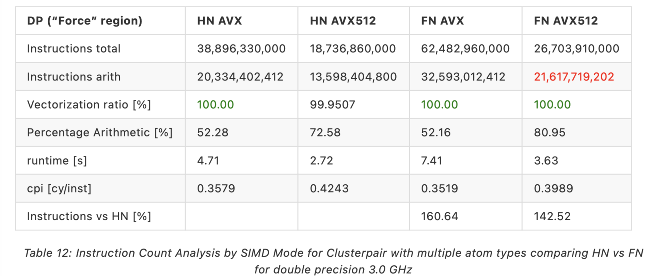
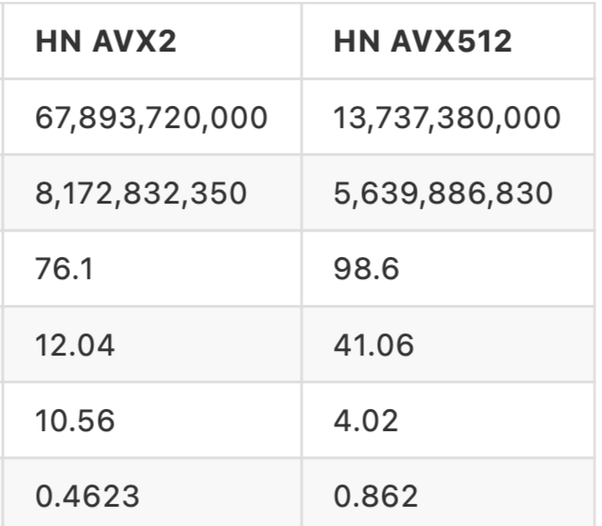
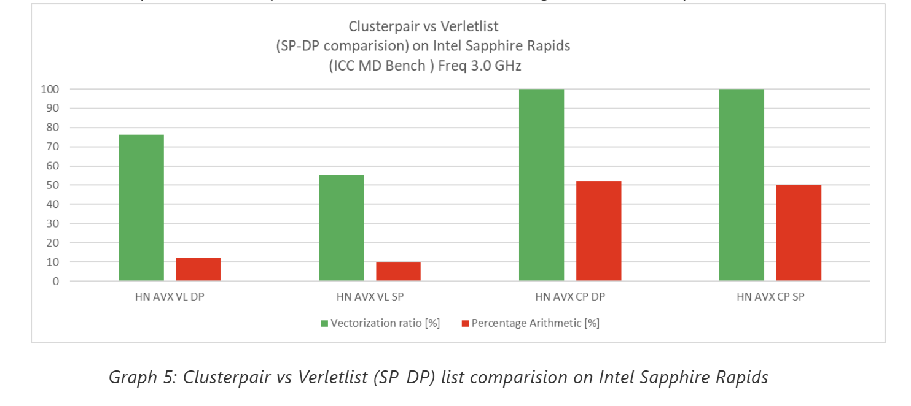
Clusterpair vs Verletlist
Verletlist comparison
Clusterpair achieves a higher vectorization ratio (100%) and % arithmetic compared to Verletlist in both single and double precision.
The Clusterpair half-neighbor list, has a higher vectorization ratio, increased percentage of arithmetic operations, and reduced runtime in comparison with Verletlist.
Verletlist is constrained by the number of instructions but Clusterpair improves efficiency by eliminating gathers but it comes at the cost of significantly increased arithmetic instructions.

Slide 13
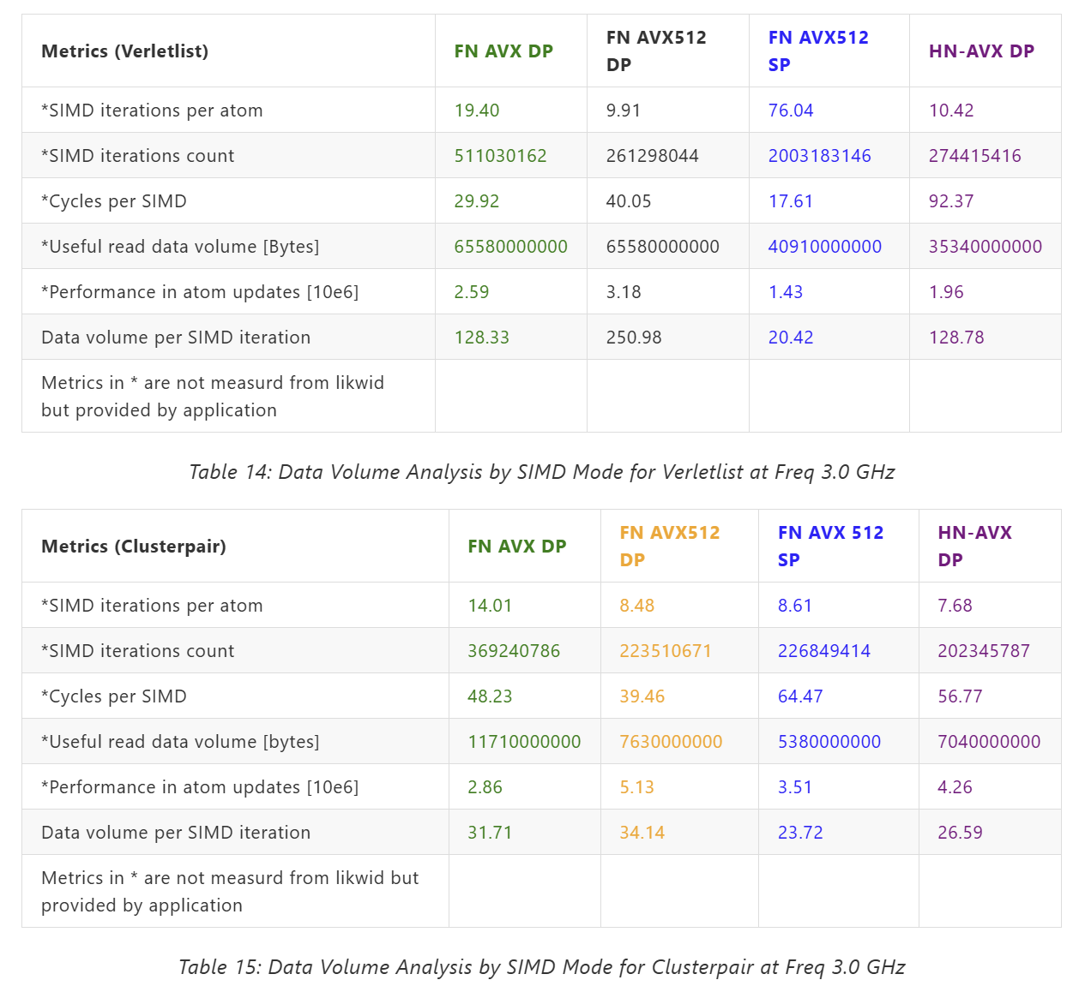
Data volume analysis
Clusterpair outperforms Verletlist in atom updates (5.13M vs. 3.18M).
CP has less useful read data volume (7.63 GB vs. 65.58 GB in VL).
SP modes consume less data but lag in performance.
AVX512 DP offers the best performance for both VL and CP

Slide 14
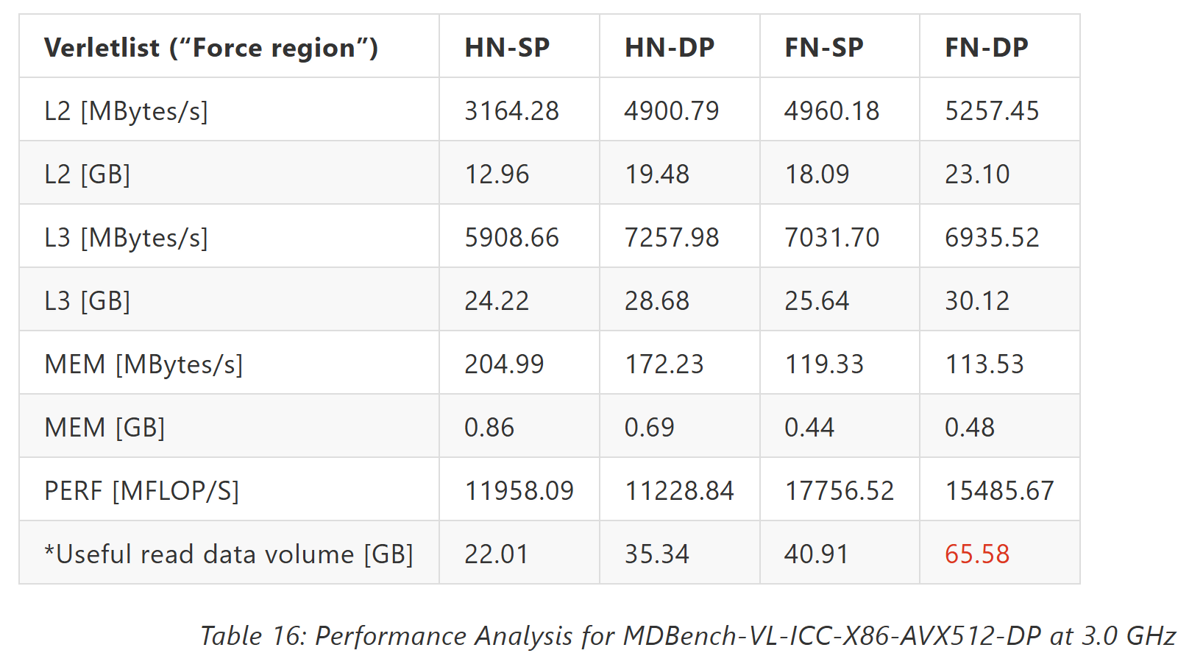
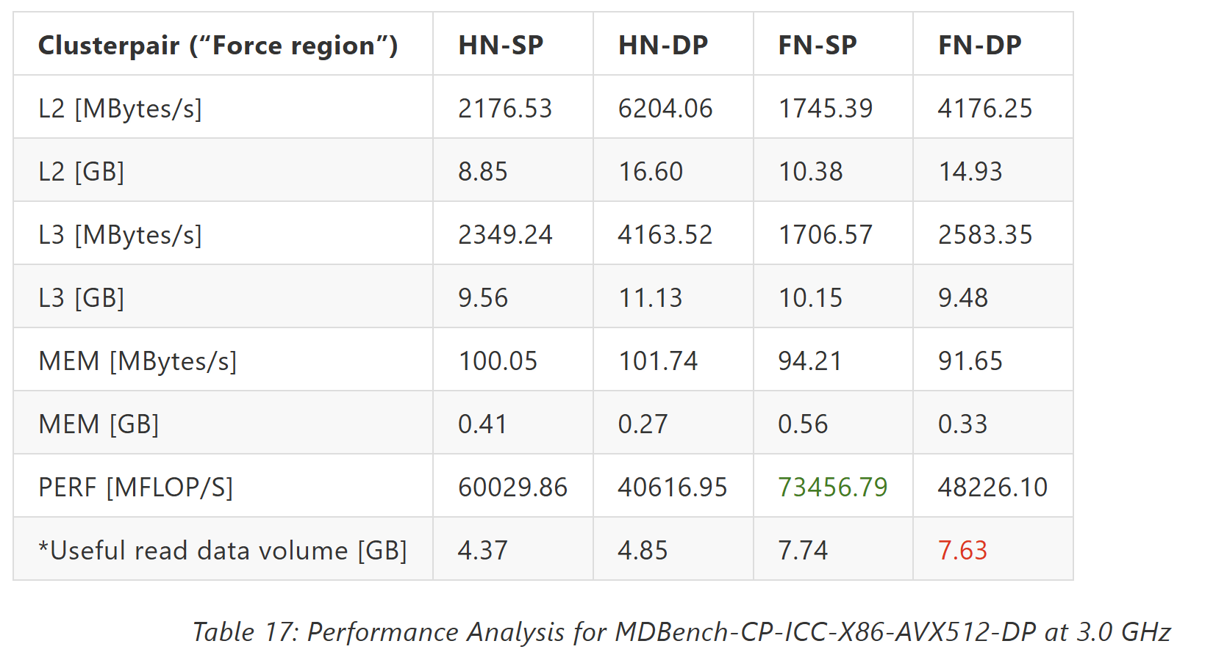
Performance Analysis
srun --cpu-freq=3000000-3000000:performance
likwid-perfctr -C 0 -g MEM/L2/L3 -m ./MDBench-VL-ICC-X86-AVX512-DP
Two Intel Xeon Platinum 8470 processors (Sapphire Rapids architecture), with 2 sockets, 104 cores (52 per socket), and 208 hardware threads.
48 kB L1 per core, 2 MB L2 per core group, and 105 MB shared L3.
Clusterpair outperforms Verletlist in all configurations (FN vs HN, SP vs DP) due to better memory locality. It achieves the highest performance (73456.79 MFlops/s in AVX512 FN-SP).
Single precision in case of Clusterpair seems to be giving better performance than double precision while in Verletlist, there is no improvement in performance.
Both optimization schemes minimize main memory access, effectively reusing data stored in L2 and L3 caches.

Slide 15
Multicore

Slide 16
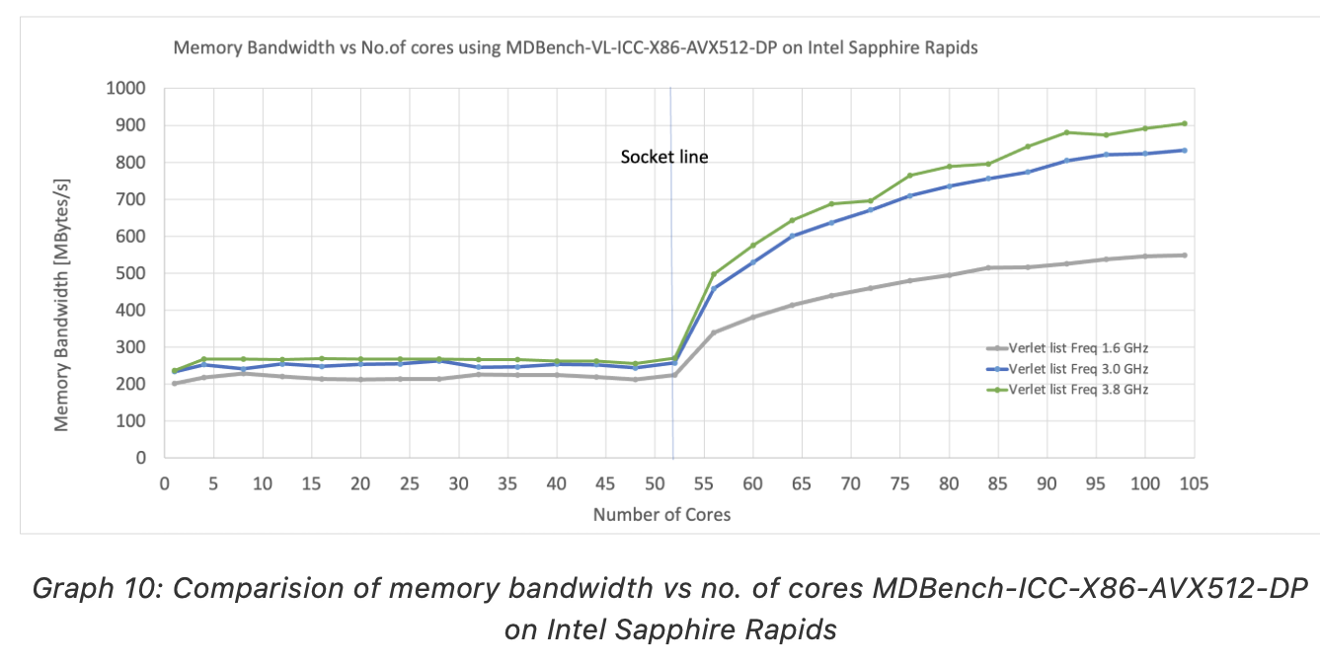
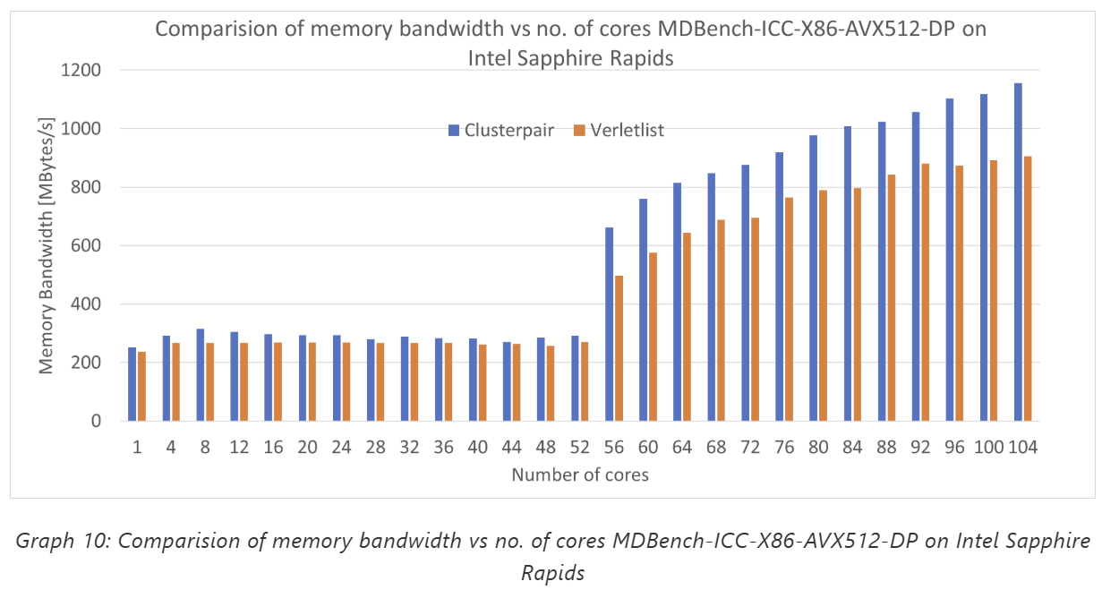
Memory BW
srun -n 1 -c 208 --cpu-freq=3000000-3000000:performance likwid-perfctr -c S0:0@S1:0 -g MEM likwid-pin -c N:0-52 ./MDBench-VL-ICC-X86-AVX512-DP
A similar trend is observed with the cluster pair, though the corresponding values are consistently higher in magnitude.
After 52 physical hardware threads, the socket changes, causing issues in pure OpenMP cases due to main process data allocation. Data structures like "atom lists" are typically allocated by the main process or master thread, which resides on the first socket.
Threads accessing remote memory create significant interconnect traffic, especially on one socket.
Pinning workloads to specific socket cores does not guarantee memory accesses stay local, as remote socket memory allocation increases traffic and latency.
With fewer threads, the interconnect performs adequately, but at high thread counts (~80 cores), bandwidth saturation occurs.
The second socket generally experiences lower traffic compared to the first.

Slide 17
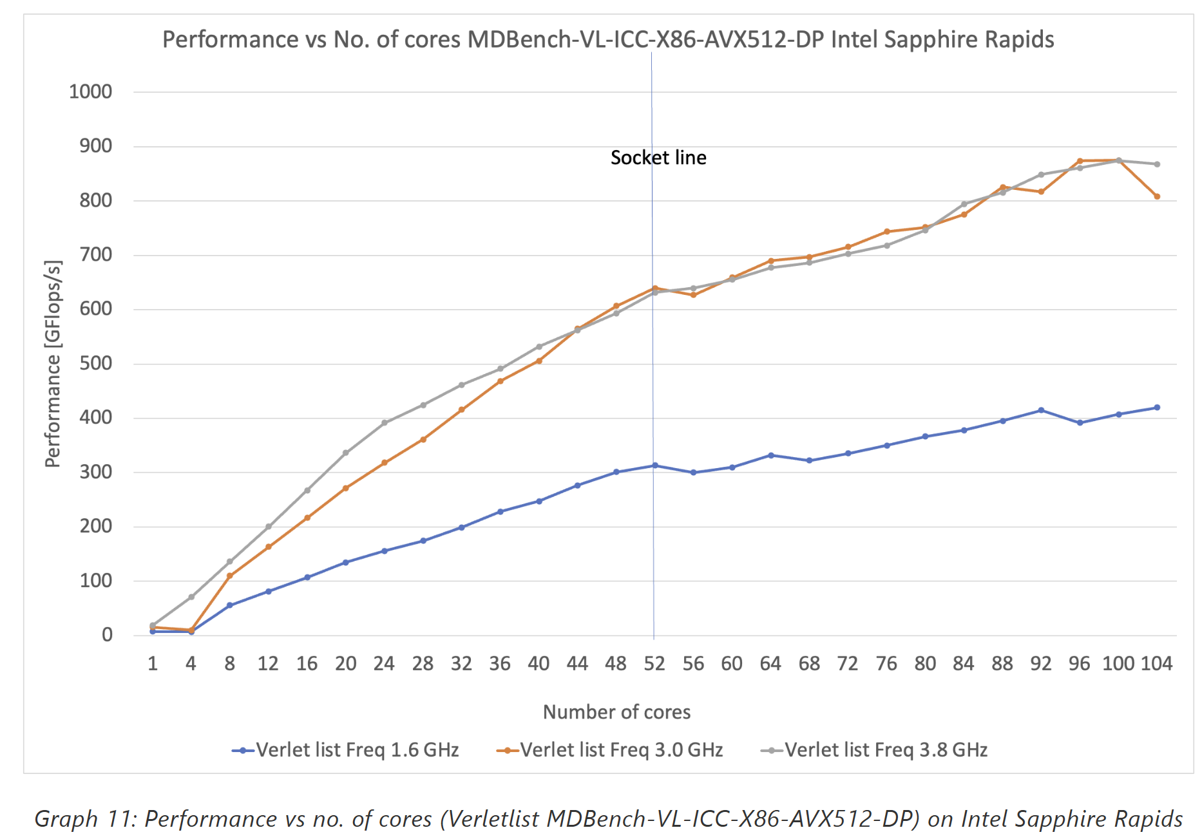
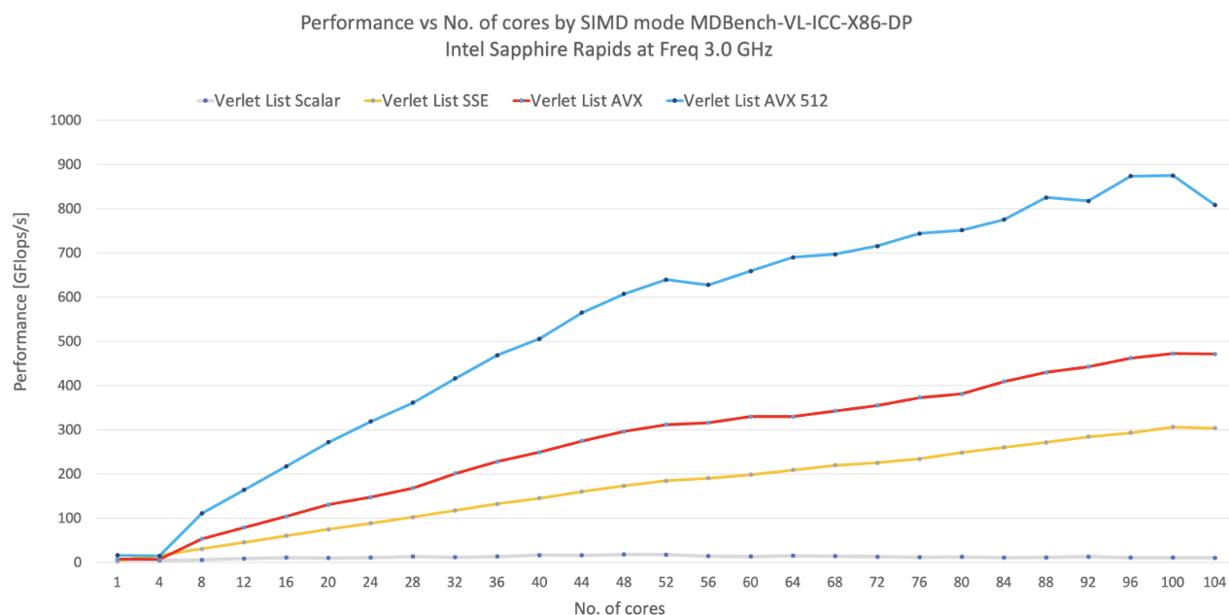
Scalability Verletlist – Performance with varying frequency
Performance generally increases with the number of cores at higher frequencies as tasks are executed faster. Non-linear improvement becomes noticeable when the number of cores exceeds 64, indicating saturation or diminishing returns.
Higher frequencies (3.0 GHz and 3.8 GHz) deliver better performance compared to 1.6 GHz across all core counts
For the 3.8 GHz (turbo) configuration, performance peaks around 96 cores. Performance begins to decline slightly beyond 96 cores, likely due to overhead, contention issues, or workload-related factors.
As core count rises, performance improves across all frequencies, demonstrating scalability.
SIMD mode
Performance in full neighbourlist improves significantly with advanced SIMD modes: Scalar offers the lowest performance, SSE provides a slight boost, while AVX and AVX512 deliver much higher performance, with AVX512 achieving the best scalability, at ~850 GFLOPs/s on 104 cores.
Scalar mode scales poorly and is inefficient at high core counts, whereas AVX and AVX512 scale well, with AVX512 maintaining near-linear scaling up to ~96 cores before leveling off.

Slide 18
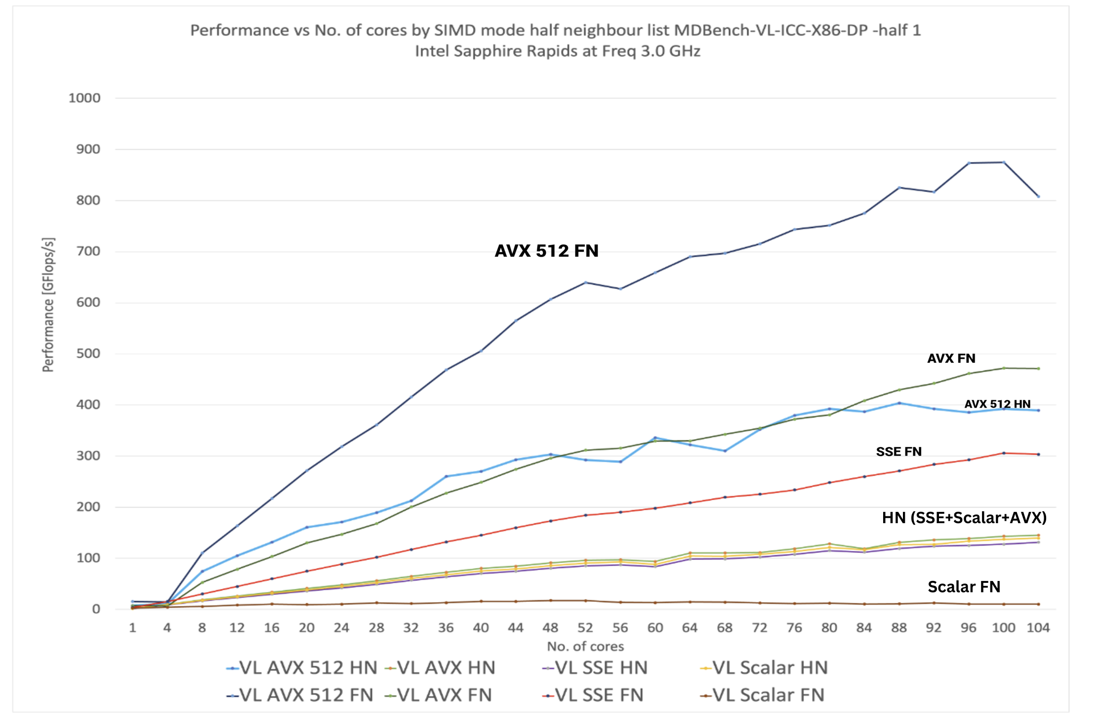
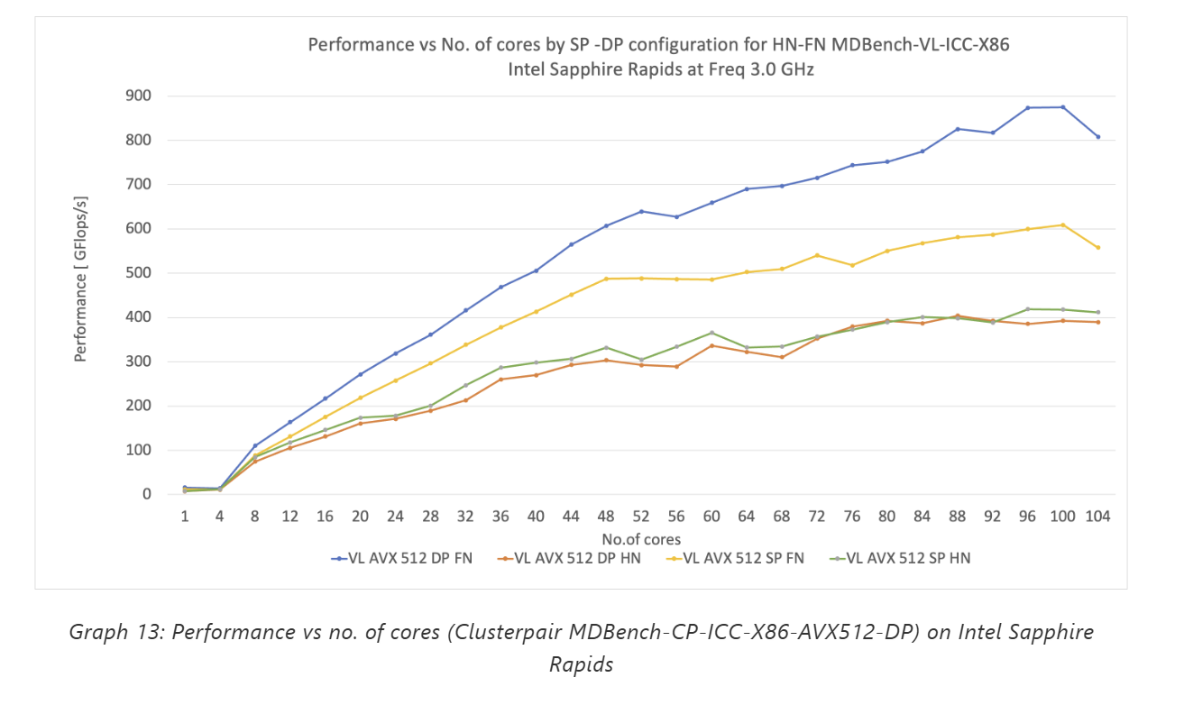
Neighbour list and precision
The Half Neighbor List (HN) scales slower than the Full Neighbor List (FN) with more cores, as FN benefits more from parallelism. FN offers better performance but at a higher computational cost, while HN is suited for simpler or resource-limited workloads.
Both HN and FN perform best with AVX-512, maximizing core and memory bandwidth utilization.
Single precision and double precision configurations in Verletlist follow a similar trend with FN curves above HN curves.

Slide 19
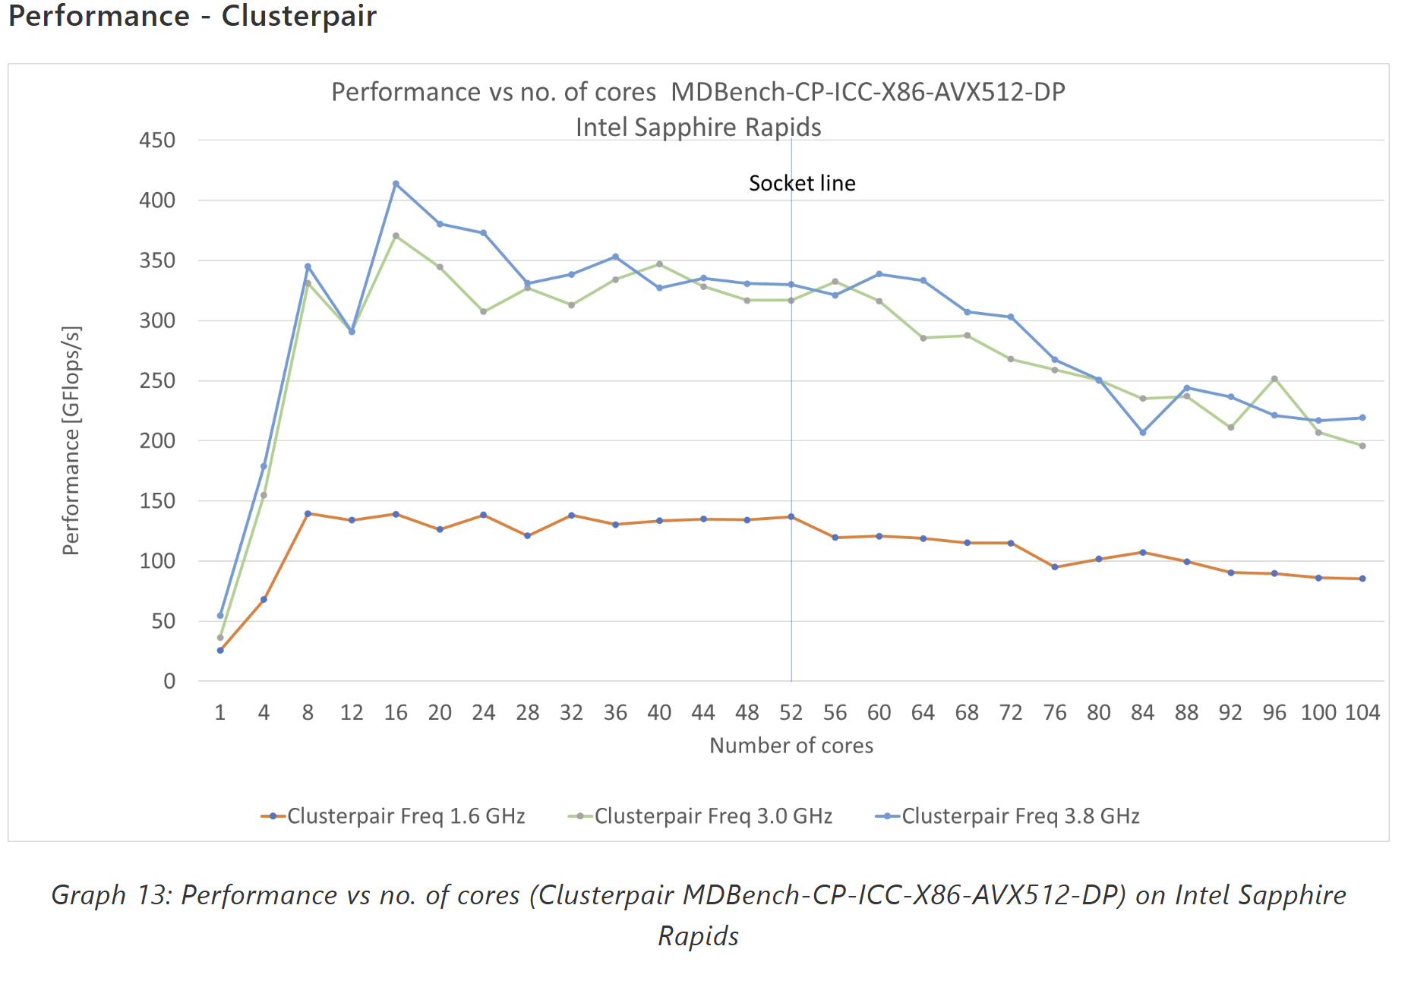
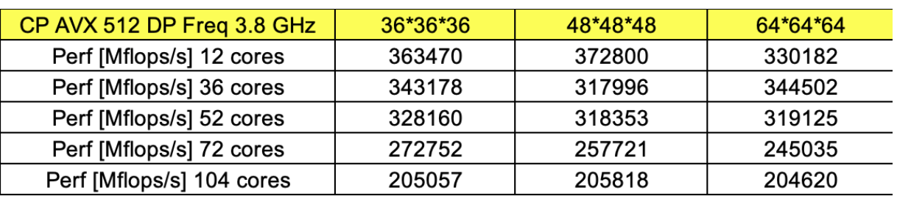
Scalability Clusterpair – Performance with varying frequency
Cluster Pair exhibits poor scalability with OpenMP. The decline in performance is likely due to insufficient work per core. It scales up to 8 cores.
The possible reasons could be memory bandwidth bottle necks, uneven workload distribution, interconnect saturation, thermal and power limits.
Increasing problem sizes does not appear to resolve the workload issue.
Workload is distributed based on the number of particles in clusters. However, if particle density is uneven, some clusters may have significantly more work, leaving some cores idle while others are overloaded.

Slide 20
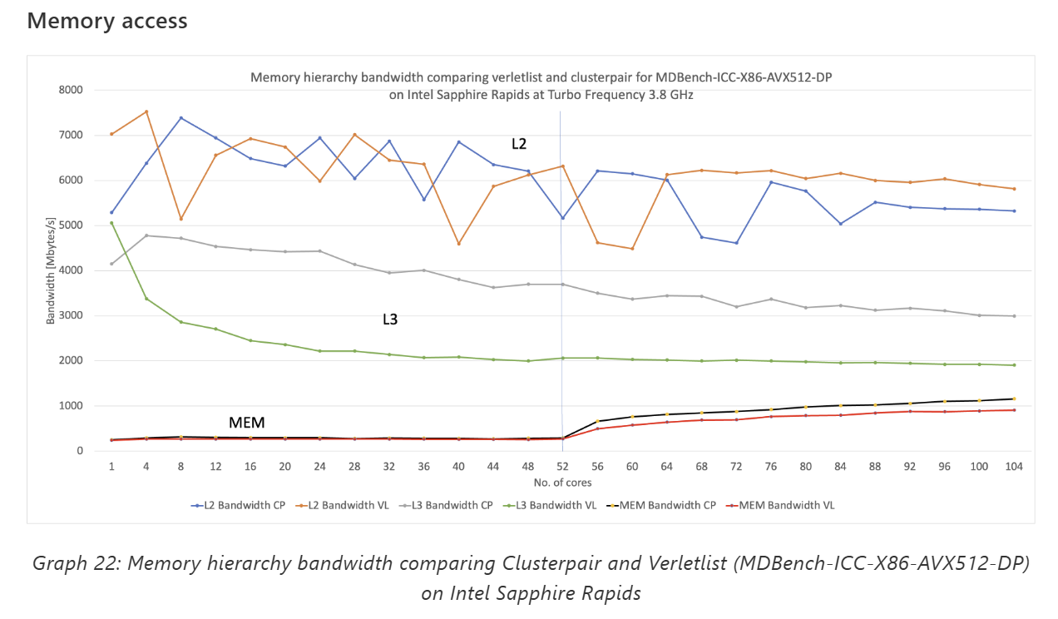
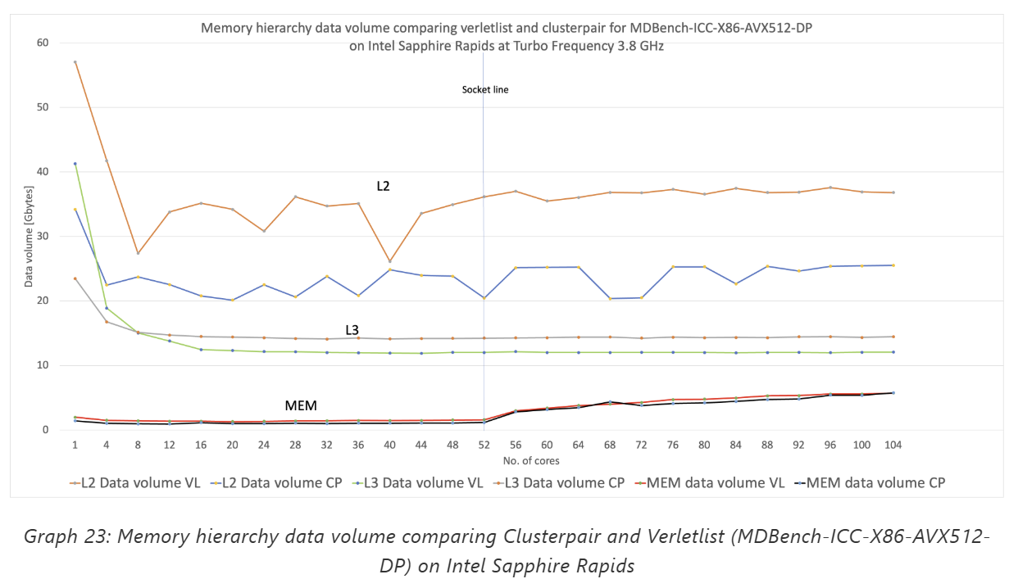
Scaling Analysis: Verlet List vs Cluster Pair
Memory Access
CP exhibits a clear advantage by significantly reducing load volumes for L3 cache and, to a lesser extent, for L2 cache.
CP’s superior memory layout efficiency, which minimizes unnecessary memory fetches and leverages cache hierarchies more effectively.
Bandwidth measurements confirm that memory bandwidth is not a bottleneck. Benchmarks on Intel Sapphire Rapids show usage remains within the bandwidth cap, ranging from 32.45 GB/s (single core) to 60 GB/s (8 cores).

Slide 21
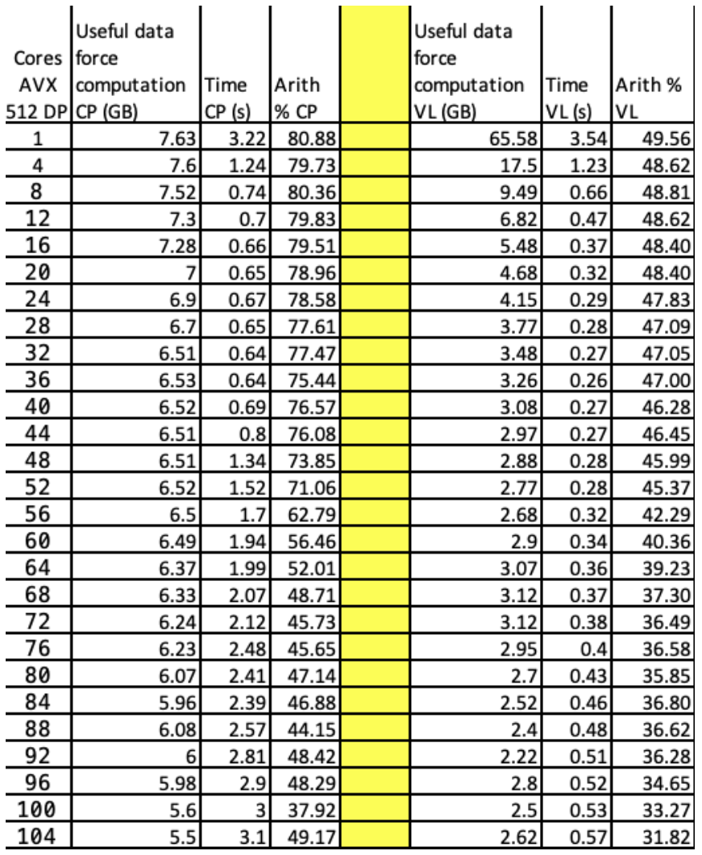
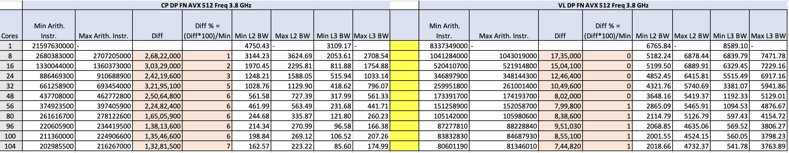
Scaling Analysis: VL vs CP
Workload distribution
- The trade-off between arithmetic instructions and data access highlights CP's efficiency in memory access and SIMD-optimized data storage, requiring fewer instructions for organization. However, CP performs nearly 3x more computations than VL, which limits the overall time savings despite its advantages.
- The uneven distribution of arithmetic instructions in CP, as seen in the min/max values, indicates workload imbalance, which may hinder scaling. It is also possible that certain HW threads are struggling.

Slide 22
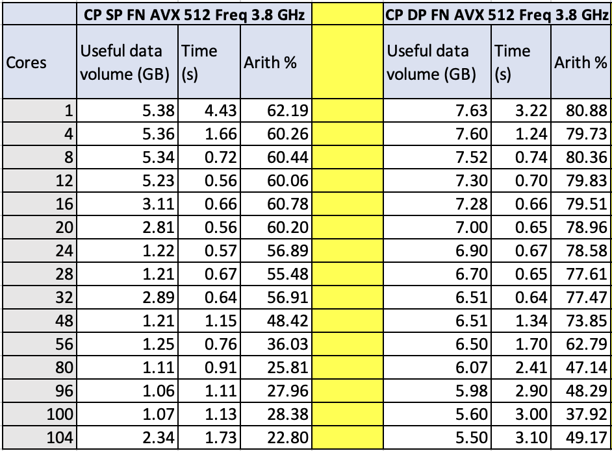
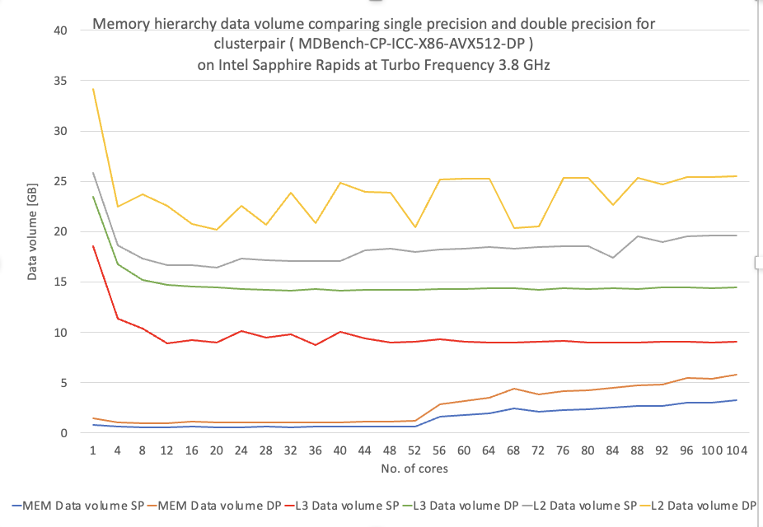
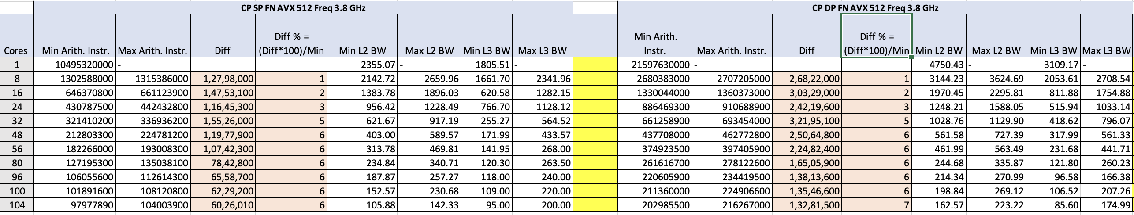
Scaling Analysis: Cluster Pair SP vs DP
L2
L3
MEM

Slide 23
Energy analysis
srun -n 1 -c 208 --cpu-freq=3000000-3000000:performance likwid-perfctr -c S0:0@S1:0 -g ENERGY likwid-pin -c N:0-103 ./MDBench-CP-ICC-X86-DP
srun -n 1 -c 208 --cpu-freq=3000000-3000000:performance likwid-perfctr -m -C N:1-52 -g FLOPS_DP
./MDBench-VL-ICC-X86-AVX512-DP
Z-Plot Visualization:
Plots energy to solution against performance (inversely related to runtime)
Third variable (e.g., processor frequency or core count) represented along the line
Highlights efficiency across configurations
Energy to Solution:
Total energy consumed by a complete run or a portion of the application. Likwid-perfctr ENERGY group measures PKG Energy/Power and DRAM Energy/Power, summed up which gives us the required value.
Both ENERGY and MEM are socket-specific counters, meaning they exist only once per socket. Consequently, LIKWID reads them using a single hardware thread per socket.
Energy-Delay Product (EDP):
Used to find a compromise between low energy consumption and good performance. Constant Energy-Delay Product (EDP) appears as straight lines radiating from the origin.

Slide 24
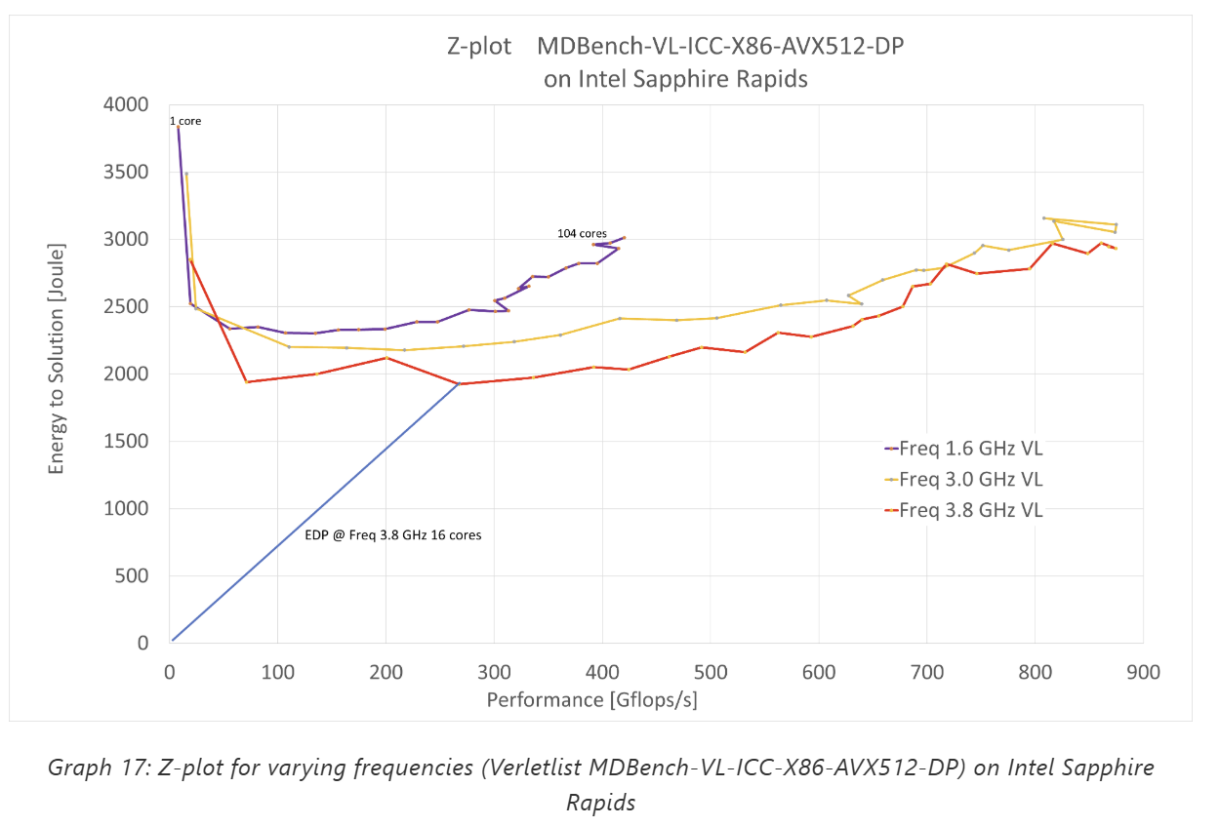
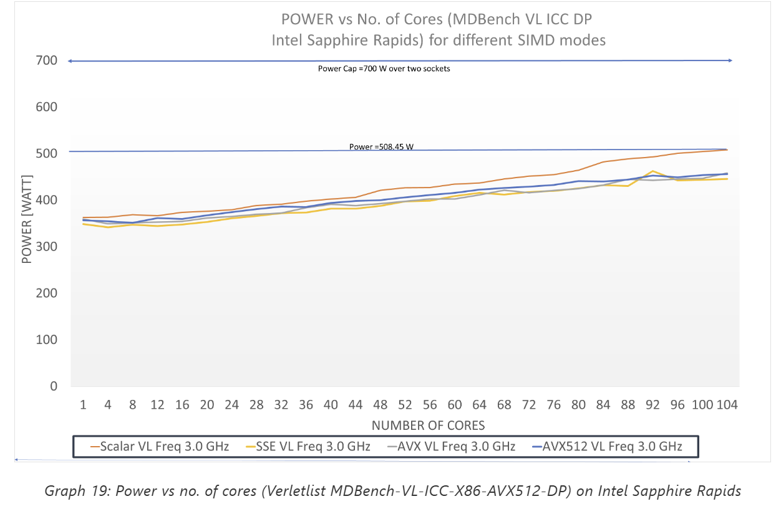
Z-plot - Verletlist
The more cores we use at a given clock speed , the lower the energy to solution till socket change happens after core 52 where there is an increase in energy to solution
Increasing clock speed raises energy consumption for large core counts, but for smaller core counts, there appears to be an optimal clock speed (3.8 GHz) that minimizes energy.
The energy-delay product (EDP) goes down as the frequency goes up at fixed core count. In our example it is lowest at 16 cores and freq 3.8 GHz (blue line).
Thermal throttling or power limits may restrict full-speed operation. The key takeaway is balancing performance and energy use to find the optimal trade-off for each application.

Slide 25
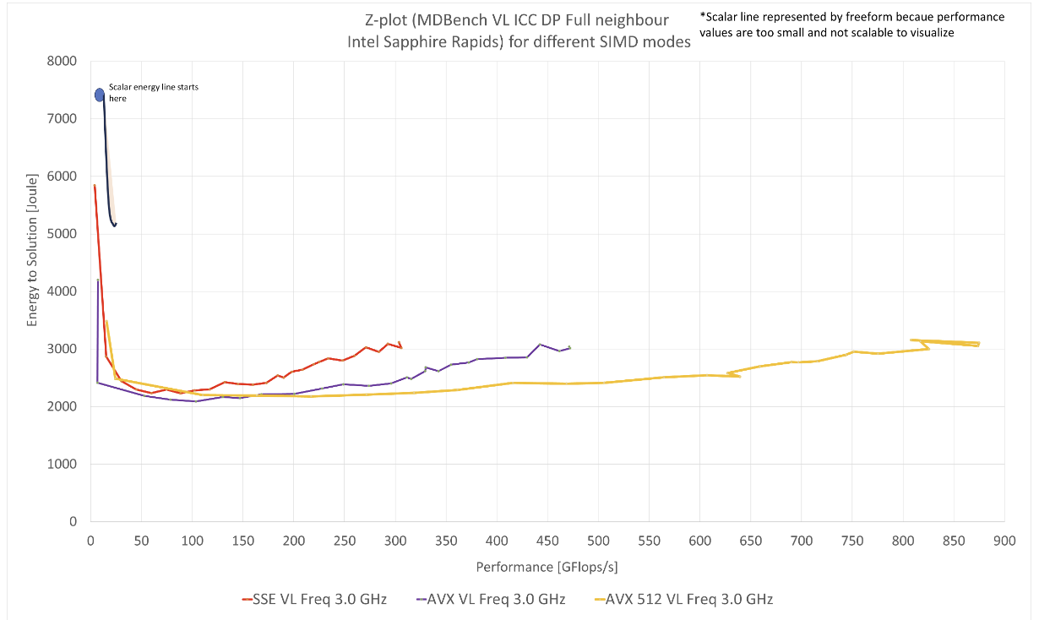
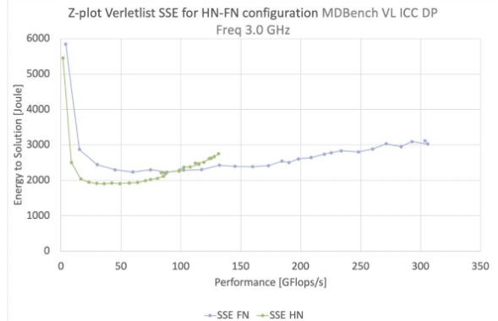
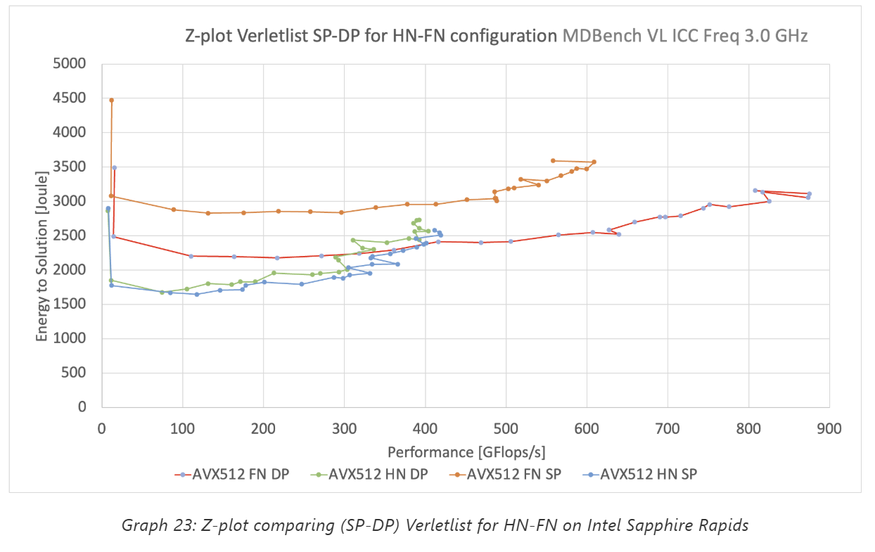
Z-plot – SIMD mode, Neighbourlist and Precision
Among the SIMD implementations, AVX-512 stands out, achieving the highest performance (~850 GFlops/s) while maintaining the lowest energy-to-solution ratio.
Scalar processing is the least efficient, highlighting the benefits of modern vectorized architectures.
The HN configuration provides lower energy-to-solution metrics but does not outperform the FN configuration in terms of energy efficiency.

